Slide 1
Rotor Hub And Pitch System
Group Members :
Dhruvin Kakdiya
Adharsh Pappinisseri Veedu
Muthu Thirunavukarasu
Syed Mohammed Sikandar
Week number : 11
Date: 09/12/2025
Supervisor: Prof. Peter Quell

Slide 2
List of contents
Hub cad model & Specification
Blade Bearing Cad model & Specification
Updated Additional Stiffening ring Model
Hub Assembly
Work to be done
Muthu Thirunavukarasu

Slide 3
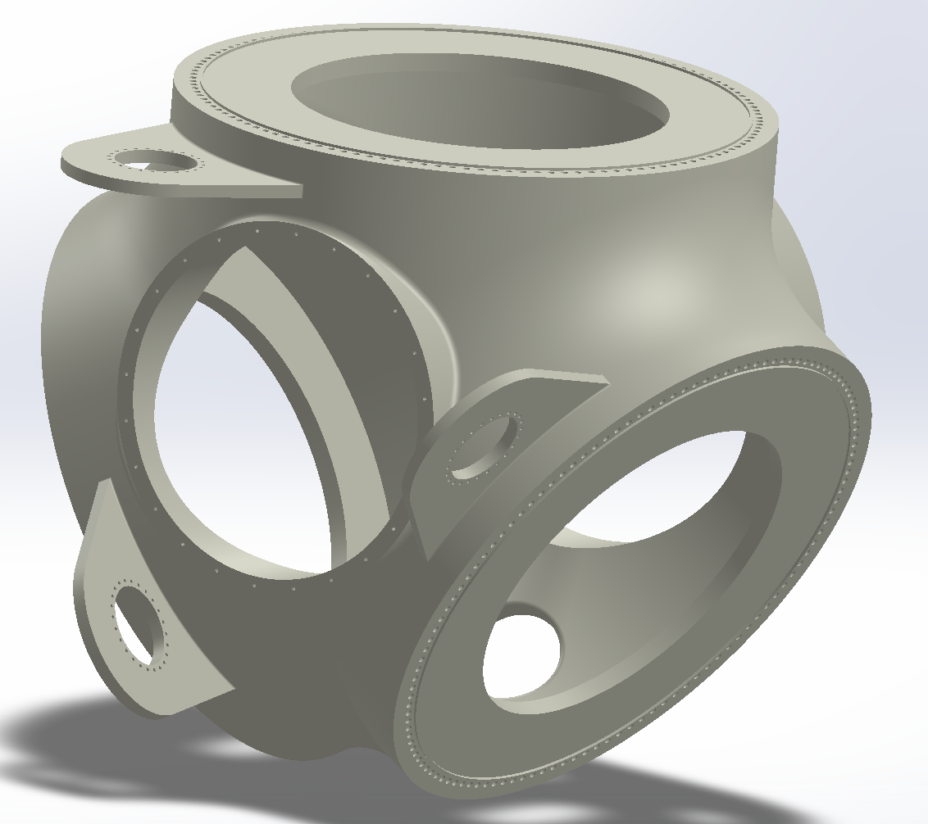
Hub cad model & Specification
Cast Iron (EN-GJS-400-18) | Value
Tensile strength | 360MPa
Compressive Strength | 275MPa
Yield strength | 220MPa
Young’s Modulus | 169GPa
Density | 7100 Kg/m³
Poisson’s ratio | 0.28
Spinner side view [ own design ]
Muthu Thirunavukarasu

Slide 4
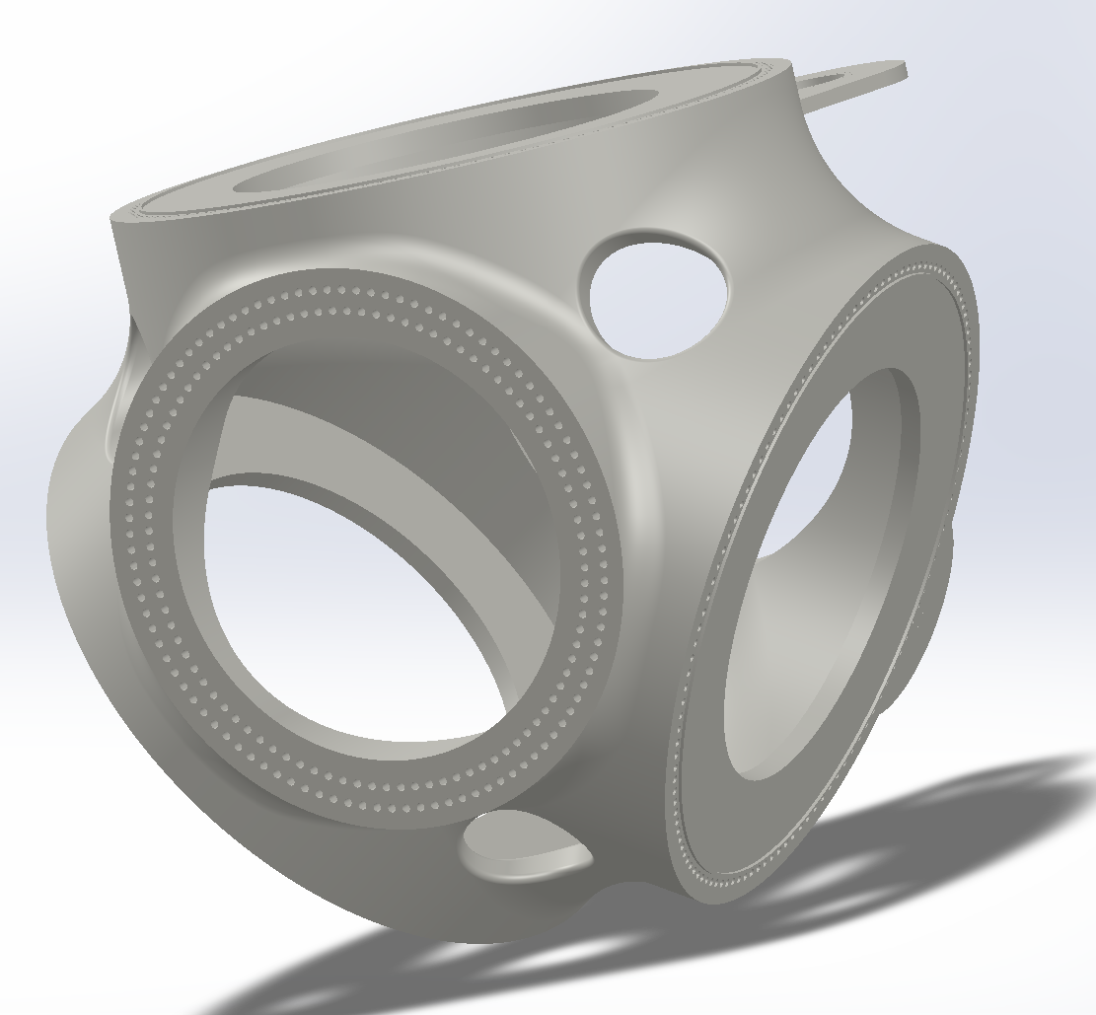
Rotor Hub
Hub diameter | 4500 mm
Cone angle | 4°
Total weight | 40 T
Material | EN-GJS-400-18
Hub to shaft BCD | 2450 mm (Outer)
 | 2250 mm (Inner)
Bolts on inner BCD | 94 * M36 ( Dia. 39)
Bolts on outer BCD | 102 * M36 ( Dia. 39)
Hub length | 3500 mm
Shaft side view [ own design ]
Muthu Thirunavukarasu

Slide 5
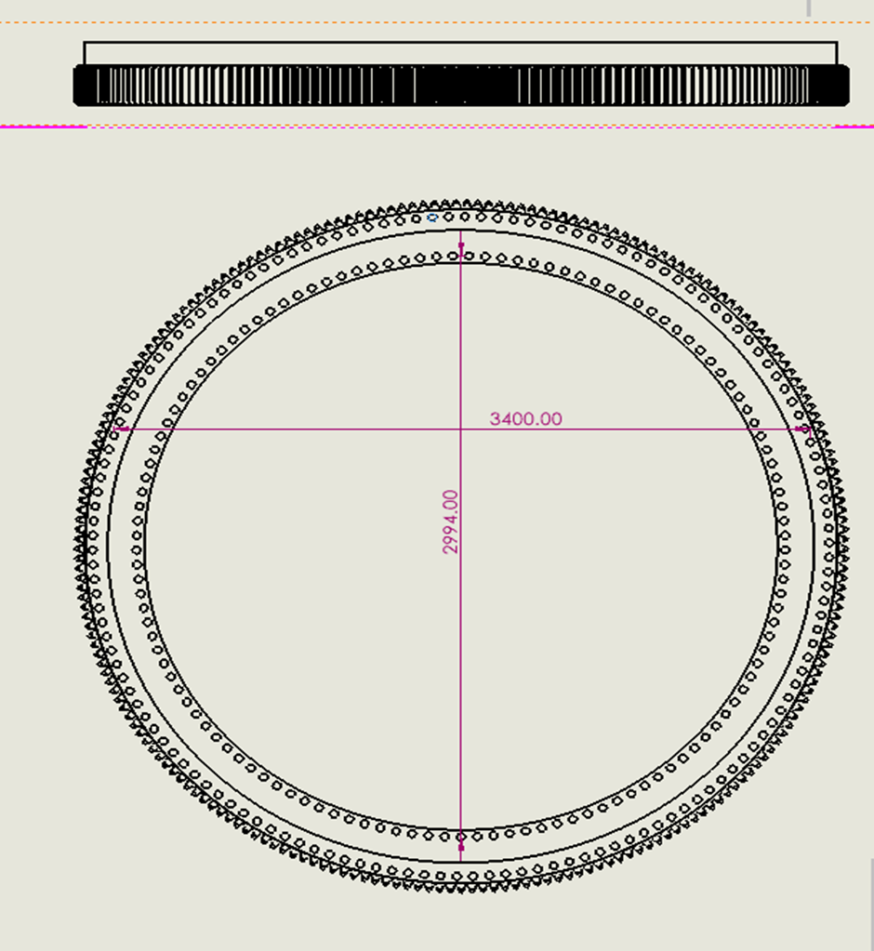
Blade Bearing Specification
Parameters | Values
Number of Bolt holes (Inner Ring) | 125 (M 36)
Number of Bolt holes (Outer Ring) | 142 (M 36)
Number of Rollers (per raceway) | 145
Gear Module | 20 mm
Pitch Circle Diameter | 3600 mm
Number of Teeth | 180
Material | 42CrMo4
Weight | 8 Tones
[ own design ]
Muthu Thirunavukarasu

Slide 6
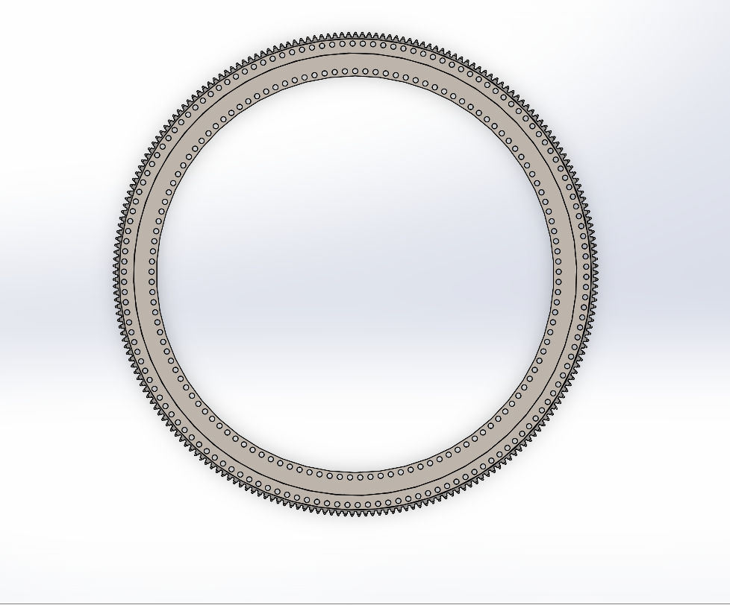
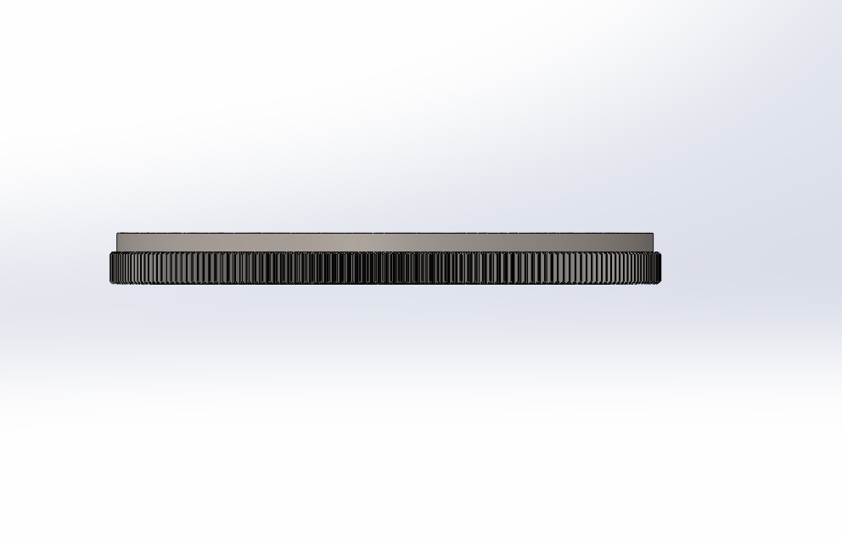
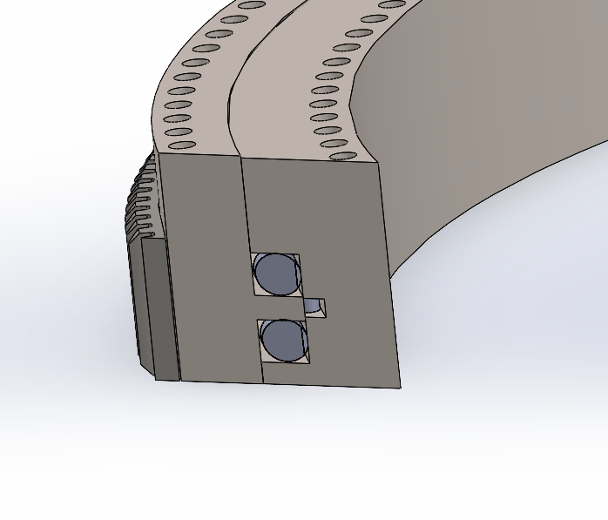
CAD Model of Blade Bearing
Front view
Top view
[ own design ]
Sectional view
Muthu Thirunavukarasu

Slide 7
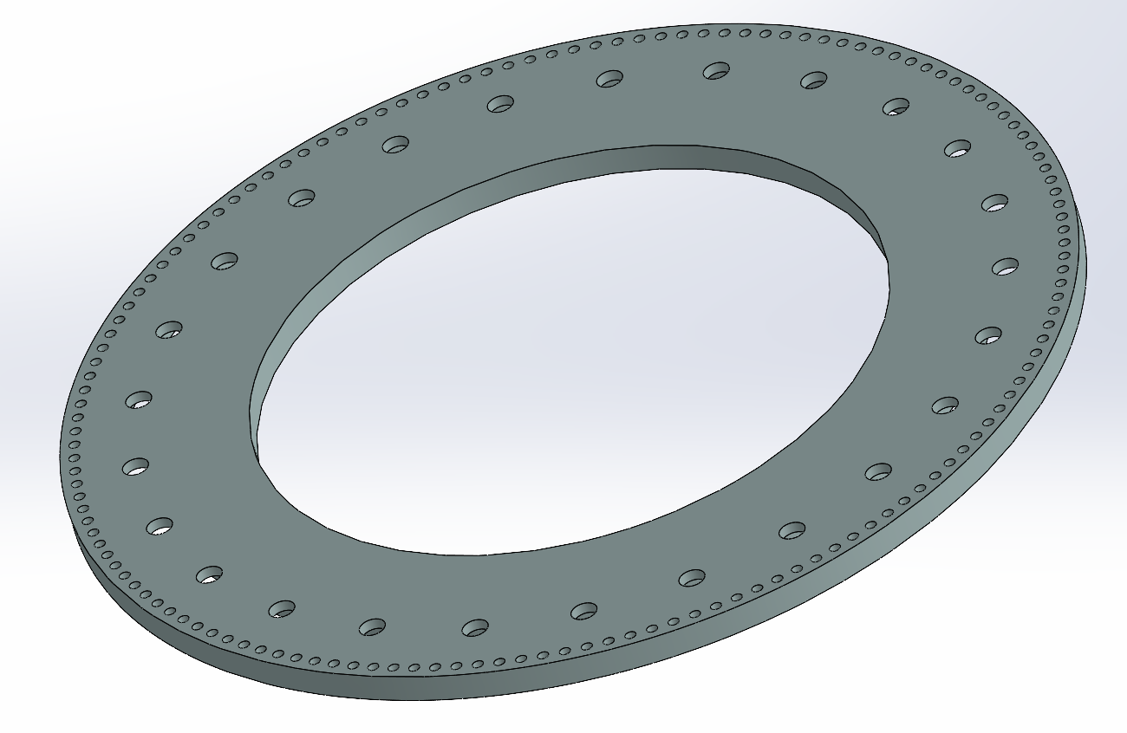
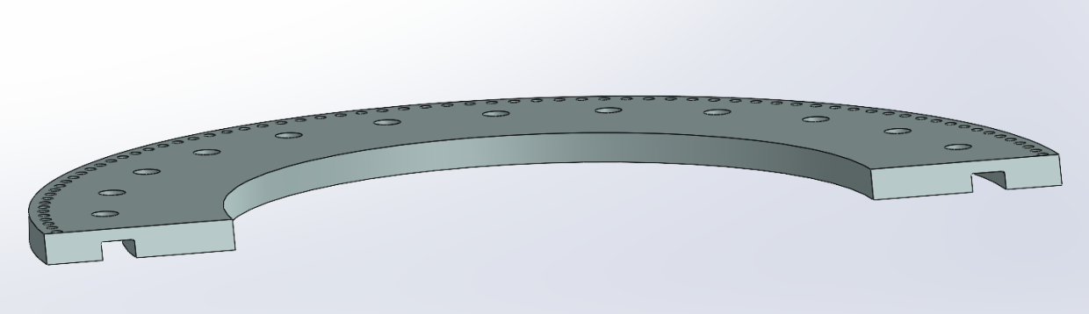
Updated Additional Stiffening ring Model
Additional Stiffening ring
Total weight | 3.5 T
Material (same as Hub) | EN-GJS-400-18
No. of Rings | 3 (Each per blade)
Holes for Bolts on inner BCD (Inspection of bolts on inner ring) | 25 * D100
Hole for Bolts on outer BCD (For blade connection) | 142 * D38
Ring thickness | 100 mm
[ own design ]
Cross-section view [ own design ]
Muthu Thirunavukarasu

Slide 8
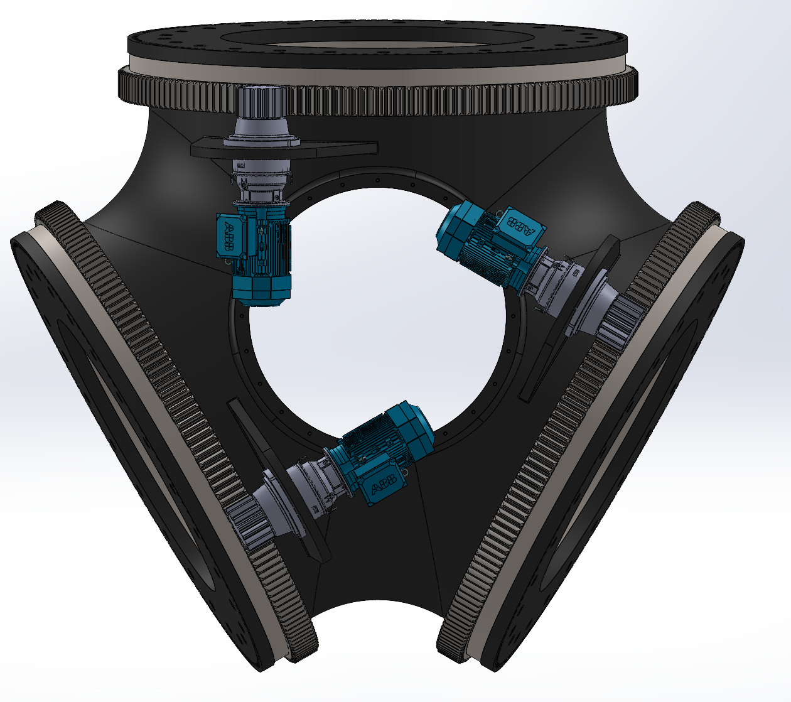
Hub Assembly
Included components:
Rotor hub
Blade Bearing
Additional Stiffening ring
Gear box
Electric Motor
Remaining components:
Spinner
Spinner connection ring
Batteries fitting
Inverter fitting
Pitch pinion
Pitch bearing cover
[ own Assembly ]
Muthu Thirunavukarasu

Slide 9
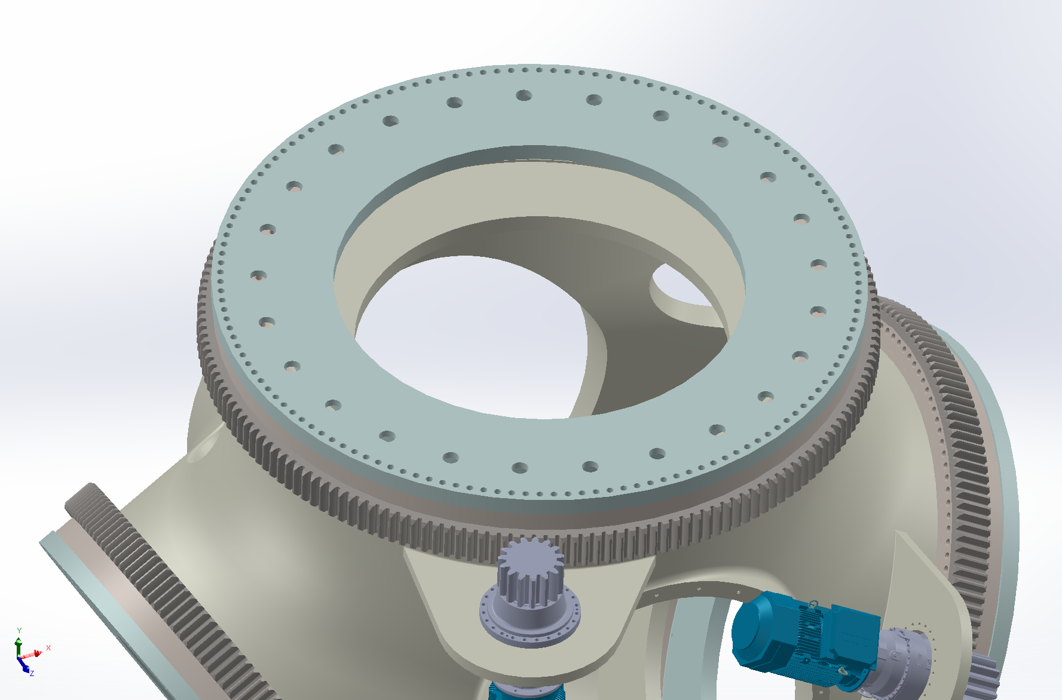
Additional Stiffening ring
Blade Bearing
Gear box
Electric Motor
[ own Assembly ]
Muthu Thirunavukarasu

Slide 10
Work to be done
Work on Pending component ( already contacted company for suitable batteries and expecting reply this week)
Assembly adjustments
Analysis of Hub and spinner
Muthu Thirunavukarasu

Slide 11
Bibliography
Project report Optimus shakti 5.0 [05.12.2025]
Project report Optimus Ocean 17.0 [05.12.2025]
Chapter 7 and 8 of DNV GUIDELINES (DNVGL-ST-0361, Edition September 2016) https://github.com/Karim-bakhtyar/Optimus-Syria-WEC/tree/main/6_Documentation_Archive/Guidelines [06.12.2025]
Muthu Thirunavukarasu

